Slide 1





PhonePe Digital Payment trends analysis with sql and powerbi

Slide 2

Dataset
Aggregated Transactions : Captures transaction data aggregated by state, year, and transaction type
Top Users by Pincode : Provides insights into the number of registered users by pincode for a given state and quarter
Top Users by District : Contains district-level user data, along with geographic details like latitude and longitude.
Top Transactions by Pincode : Provides transaction details at the pincode level, including counts and total amounts.

Slide 3
Dataset
Top Transactions by District : Tracks the transaction count and amounts at the district level with geographic context.
User Demographics by District: Provides user engagement metrics like app opens, alongside district-level registration data.
Transaction Metrics by District: Captures district-wise transaction metrics, including geographic identifiers.

Slide 4


Data Analysis with sql
(tool used MySQL)

Slide 5
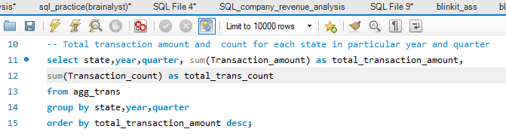
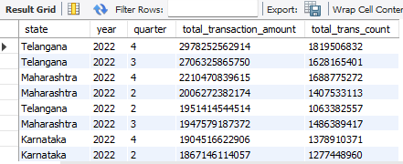
state wise transaction amount and count analysis by year and quarter
SQL Query
Output

Slide 6
Insights Obtained
Telangana has the highest total transaction amount in quarter 4 (i.e. Oct -Dec) 2022,with approximately Rs 29.78 billion .
Telangana also leads in transaction count for Q4 2022,with over 1.81 billion transactions, showcasing its dominance in digital transactions.
Maharashtra has total amount Rs 22.10 billion and Karnataka has Rs 19.04 billion transaction amount but yet they lag behind Telangana for the same periord i.e Q4.

Slide 7
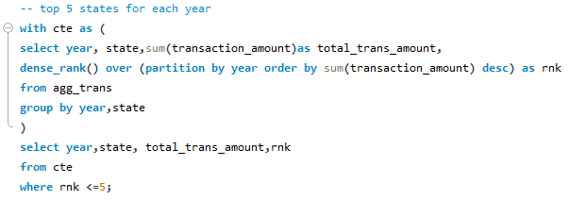
Top 5 Performing States for each year by transaction Amount
SQL Query

Slide 8
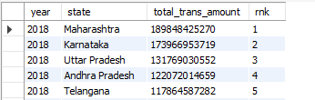
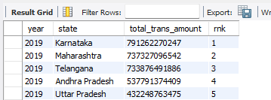
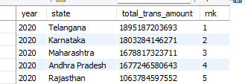
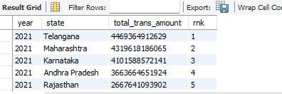
output

Slide 9
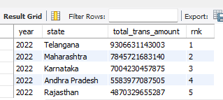
output
insights obtained
In 2018, Maharashtra has been a top state with total transaction amount Rs 18.9 billion.
In 2019,Karnataka has been leading with Rs 79.12 billion.
In 2020,2021and 2022, Telangana has consistently been a top performing state in terms of transaction amount,it demonstrates Telangana’s strong infrastructure and its citizens’s preference for cashless payment methods.

Slide 10
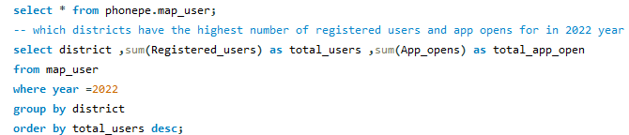
Districts in terms of highest no of registered users for 2022 year
SQL Query

Slide 11
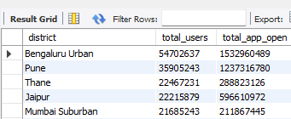
Output
INSIGHT OBTAINED
Bengaluru Urban with 54.7 million registered users and Pune with 35.9 million users are top districts among all districts of India in year 2022 especially.

Slide 12
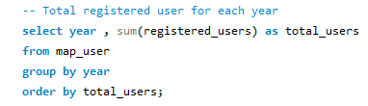
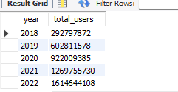
User Adoption Analysis for each year
SQL Query
OUTPUT
INSIGHT OBTAINED
The number of registered users has seen as remarkable growth from 29.28 million in 2018 to 1.61 billion in 2022,it highlights the rapid adoption of digital platforms and services.

Slide 13
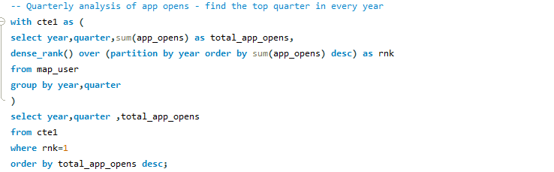
Quarterly analysis of app opens
SQL Query

Slide 14
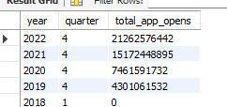
Quarterly analysis of app opens
OUTput
INSight obtained
App usage has signiificantly grown from 0 app opens in year 2018 to 2.12 billion app opens in quater 4 (i.e oct-dec) 2022 , which represents huge increase in user engagement , which shows the growing reliance on digital platforms over the years.

Slide 15
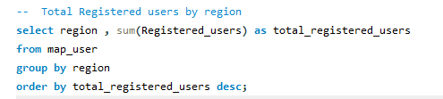
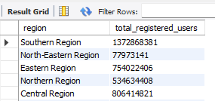
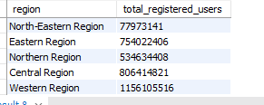
regional analysis in terms of users
sql query
output
Insight obtaiined
Southern Region is leading,simply highlights the region’s strong adoption of digital platforms and services

Slide 16
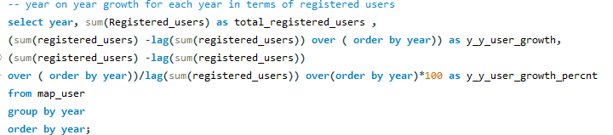
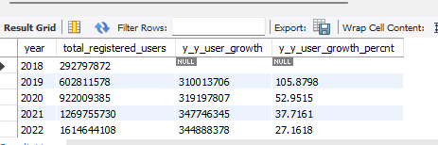
year on year growth in terms of registered users
sql query
output

Slide 17
year on year growth in terms of registered users
insight obtained
From 2018 to 2019 , registered users grew by 105.87% which is a highest growth rate , driven by increased smartphone penetration and digital initiatives.
In 2020,growth slowed but remained significant at 52.95%.
In 2021 , growth continued at 37.72% and after 2021 i.e in 2022, growth stabilized at 27.16%

Slide 18
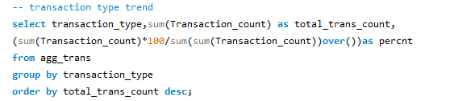
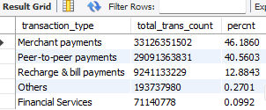
Transaction type distribution analysis
sql query
output

Slide 19
Transaction type distribution analysis
insight obtained
Merchant Payments dominate with 33.1 billion transactions i.e 46.1%, followed by Peer-to-Peer Payments at 29.1 billion i.e 40%
Recharge and Bill Payments account for 9.2 billion transactions i.e 12.8%, highlighting significant adoption.

Slide 20
DAta visualization
(tool used powerbi)

Slide 21
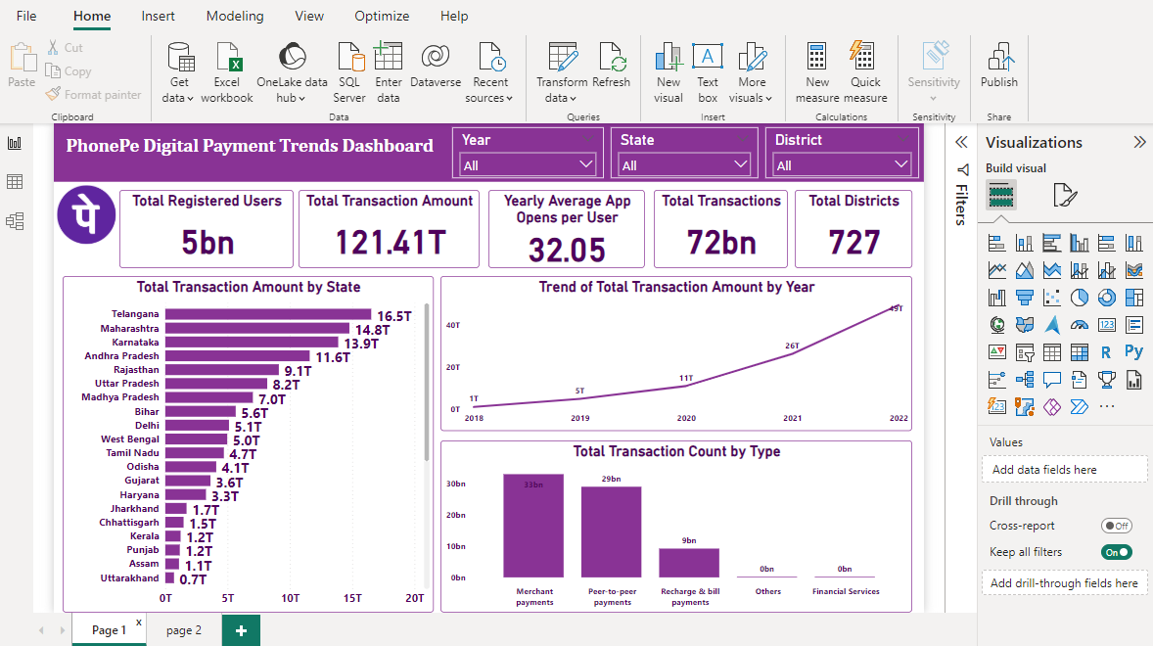

Slide 22
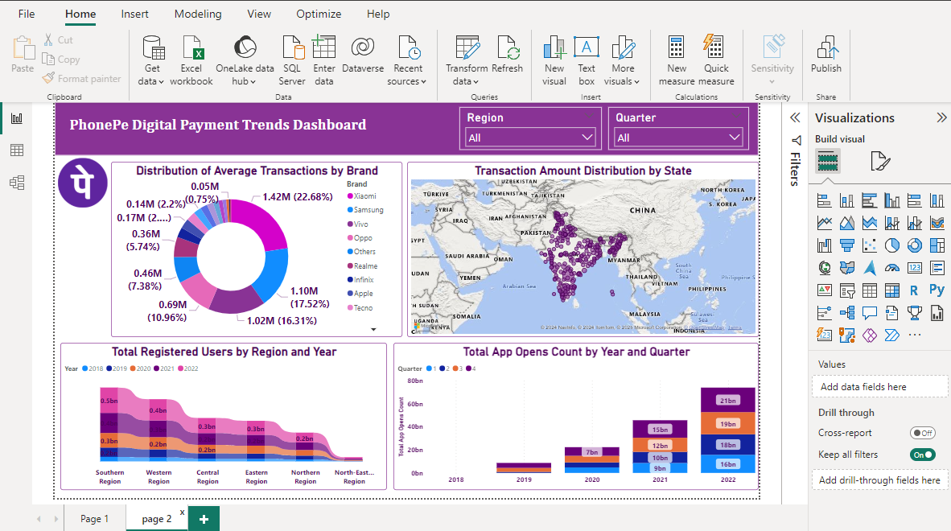

Slide 23
Thank you

